Slide 1


Man over machine
New paradigms in HR in the digital world
3 November, 2016

Slide 2
No of vehicles in US continuously increasing – 250Mn+
Number of vehicles in the US – 1900 to 2014
Number of vehicles (Mn)
2014

Slide 3
How do you think this will change by 2025?
Number of vehicles in the US – 1900 to 2014
How will this change?
Number of vehicles (Mn)
A
Rapid growth?
B
Slow growth?
C
Flat?
D
Decline?
E
Major decline?
2014
2025

Slide 4
How do you think this will change by 2025?
Number of vehicles in the US – 1900 to 2014
How will this change?
Number of vehicles (Mn)
A
Rapid growth?
B
Slow growth?
C
Flat?
D
Decline?
E
Major decline?
2014
2025

Slide 5
Driverless / Self driven vehicles a reality

Slide 6
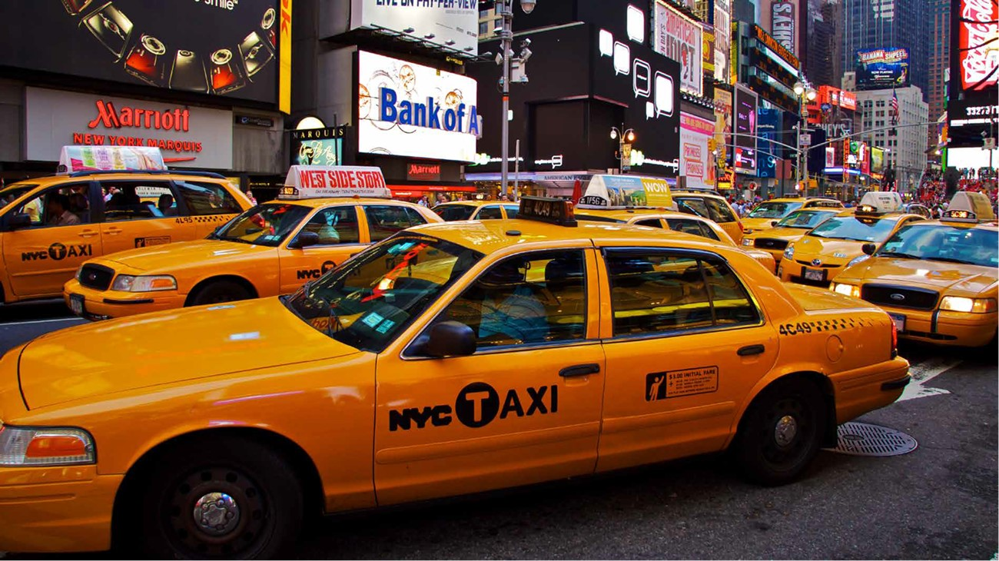
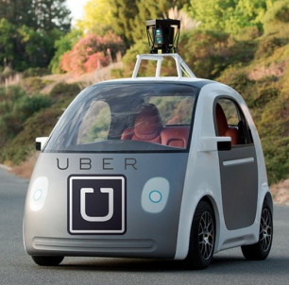
There are nearly 70k Taxis in NYC
"Uberisation" of the world
~70K cabs in NYC
  ~13k Yellow taxis
  ~13k Uber taxis
  ~10k Black cars
  ~7k Limousines
  25k+ Liveries & others
Columbia University: Just 9,000 autonomous "Uber" cars can replace every taxi cab in New York. Passengers would wait an average of 36 seconds for a ride.

Slide 7
One change – multiple impacts
  Fewer jobs – taxis, garages
  No driving – more time on hand
  Lower lending
  More fleets vs retail
Society
Banking
AUTO
Fewer cars
Car economics
changed
Insur
ance
Infra
  Empty parking spaces
  Real estate impact
  Fewer cars to insure
  From retail to liability

Slide 8
Digital is BIG and getting BIGGER
Growth in internet users in Sri Lanka
  Internet user penetration (%)
  2010
  2011
  2012
  2013
  2014
  2015
Source: Internet Live Stats

Slide 9
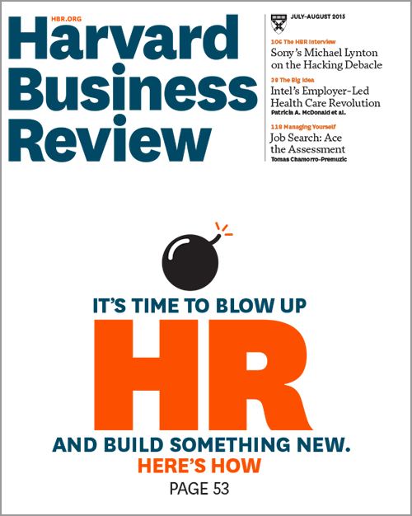
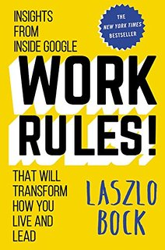
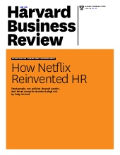
So what are here to talk about?
Ranked # 1 company to work for 6 years
Netflix culture deck: 5 MM downloads

Slide 10

Two sides of the "digital coin" for HR
Making employees "digital-ready"
Making HR
"digital-ready"

Slide 11
Two sides of the "digital coin" for HR
Making employees "digital-ready"

Slide 12
Next-gen capabilities needed
Designed (and NOT tweaked) for digital world
Big Data and Analytics
Mobile interfaces
Digital Content
Digital Tools
E - business
Digital Support

Slide 13
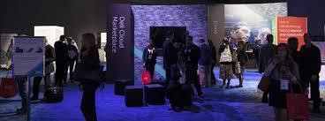
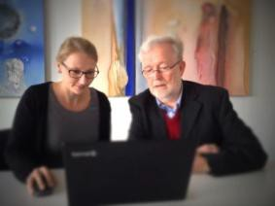




"Nurture from within"
Interventions to build in-house digital capability
Digital Roadshow
Reverse mentoring
Digital Immersion
Nurture from within
Peer to peer learning
Digital
Sprints
Experts series and workshops

Slide 14
Digital enablement – key learnings
Create digital tools - not documents
Creates sustainable change that gets embedded in organization
1
Launch early and revise (One iteration every month O-ITEM)
User inputs important in creating a user-friendly tool
2
Adoption above business results in first three months
Drive adoption aggressively through leadership
3
Think about employee's life – One source for everything
Tool design should support day-to-day activities for employees; minimise user inputs
4

Slide 15
Two sides of the "digital coin" for HR
Making HR
"digital-ready"

Slide 16
New Mental Models are Emerging
Old mental model
New mental model
"Boss decides"
"Data decides"
"Job stability" is #1
Perf Rating is # 1
Silos and departments
Agile teams
"Earn their stripes" model
Court and welcome
HR = admin
HR = culture engine

Slide 17

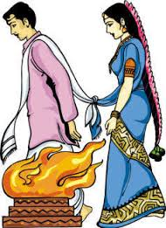

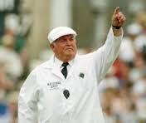

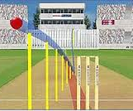
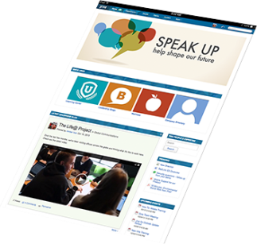



Digital in HR has changed the game
Personalized matching
Traditional training
Subjective judgement
Annual Meets
Mass media
Open source; targeted
Algorithmic matching
Customized, personalized
Objective
measurement
Online Community
Source
Transfer
Develop
Perform
Affiliate

Slide 18

Intelligent postings decisions
Thousands of positions to be filled
10+ driving factors – including government, geographic movement, retirement, hiring
Complex scoring algo to calculate best match
Employees to be transferred | Vacant Jobs
 | Job 1 | Job 2 | Job 3 | Job 4 | .... | Job 2999 | Job 3000
Employee 1 | - | 100 | 32 | -10000 | ... |  | 0
Employee 2 | 1024 | - | 256 | 16 | ... | 2 | 32
...... | ... | ... | ... | ... | ... | ... | ...
Employee 2999 | 256 | 12 | -1000 | 128 | ... | 256 | -10000
Employee 3000 | 0 | 56 | - | 32 | ... | 8 | 2
Job mismatch
Best job for employee
Score shows the goodness of each match based on the various constraints

Slide 19
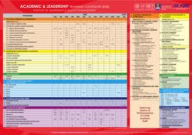
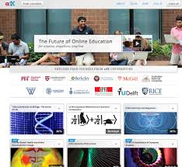
Training is undergoing massive disruption
Blackboard to keyboard (and videos)
Industrialized training
Personalized model
Annual training calendar
Standardized courses
Completion certificate
On-Demand
Customized
Real time feedback

Slide 20

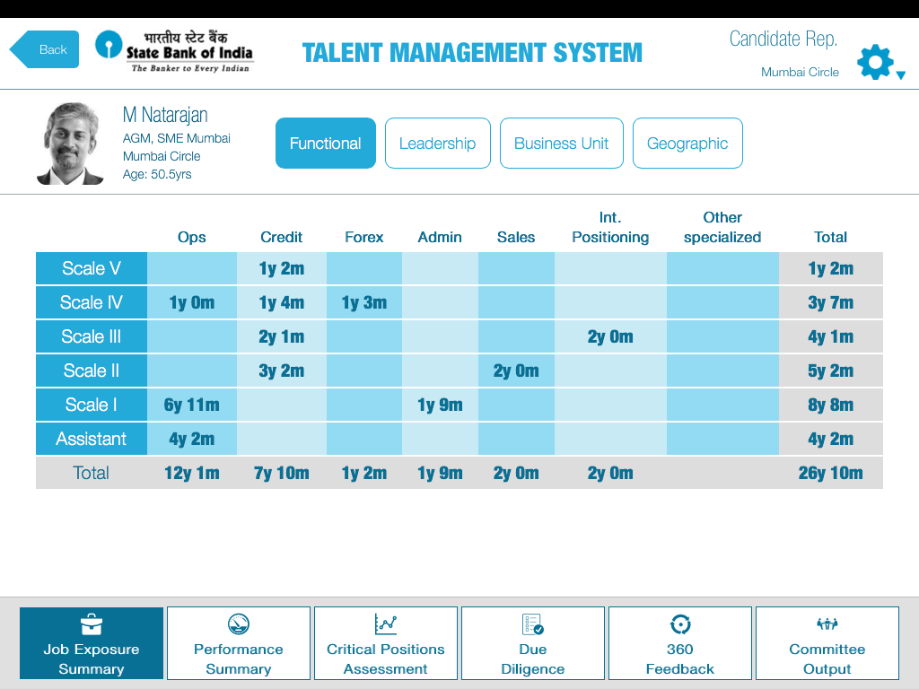
Talent management system
Do you run in-house career fairs?
Need to identify talent for successful grooming
from thousands of employees
10+ aspects of job history to be reviewed - business performance, postings, controller feedback
Digital tool to maintain employee talent file
Rep's view of a candidate
Job exposure: functional view
See or update key information about the candidate

Slide 21
The time to act is now – Let's get started!
There are risks and costs to a program of action. But they are far less than the long-range risks and costs of comfortable inaction.
John F. Kennedy

Slide 22

Thank you
bcg.com | bcgperspectives.com

