Slide 1
Story of Siddhalepa
Asoka Hettigoda
Managing Director

Slide 2
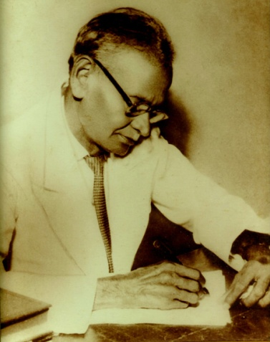
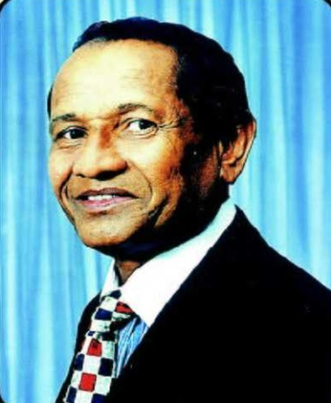
About Us
Ayurveda Heritage of Hettigoda family goes back 200 years
In 1934 Dr. Hendrick De Silva Hettigoda made Siddhalepa Balm as the first commercial Ayurvedic product
Dr. Victor Hettigoda took over the companies in 1971 and brought Ayurveda into the mainstream
Dr. Victor Hettigoda is a fifth generation Ayurvedic Doctor and considered as the father of modern Ayurveda
Kidney Specialist
Ayur Dr. Hendrick De Silva Hettigoda
Founder of Siddhalepa Balm
Deshabandu
Ayur. Dr. Victor Hettigoda, D.Litt
Chairman - Hettigoda Group

Slide 3
Siddhalepa Group
Established in 1934, as a Ayurvedic Manufacturing Company, have now diversified into Resorts, Hospitals, Spas, Fertilizer, Distribution, Printing, Plantations & City Hotel.
The first Ayurveda company in Asia to obtain ISO 9002 International Certification in 1994. Now the company has obtained ISO 9001, 14001, 22000, HACCP, GMP, FDA & EU Pharmacopeia.
The Largest exporter of Ayurvedic Products
Among Best known Sri Lankan brands in Europe, UAE and Japan
Hettigoda Industries (Pvt) Ltd
Siddhalepa Ayurveda Hospital Ltd
Siddhalepa Ayurveda Health Resort Ltd
Siddhalepa Ayurveda GmbH (Germany)
Siddhalepa Ayurveda Training Institute Ltd.
Hettigoda City (Pvt) Ltd.
Siddhalepa Ayurveda s.r.o. (Czech)
Suraya Organic Fertilizer Ltd
Hettigoda Distributors Ltd
Siddhalepa Ayurveda R&D Ltd
Hettigoda Distributors India Ltd.

Slide 4
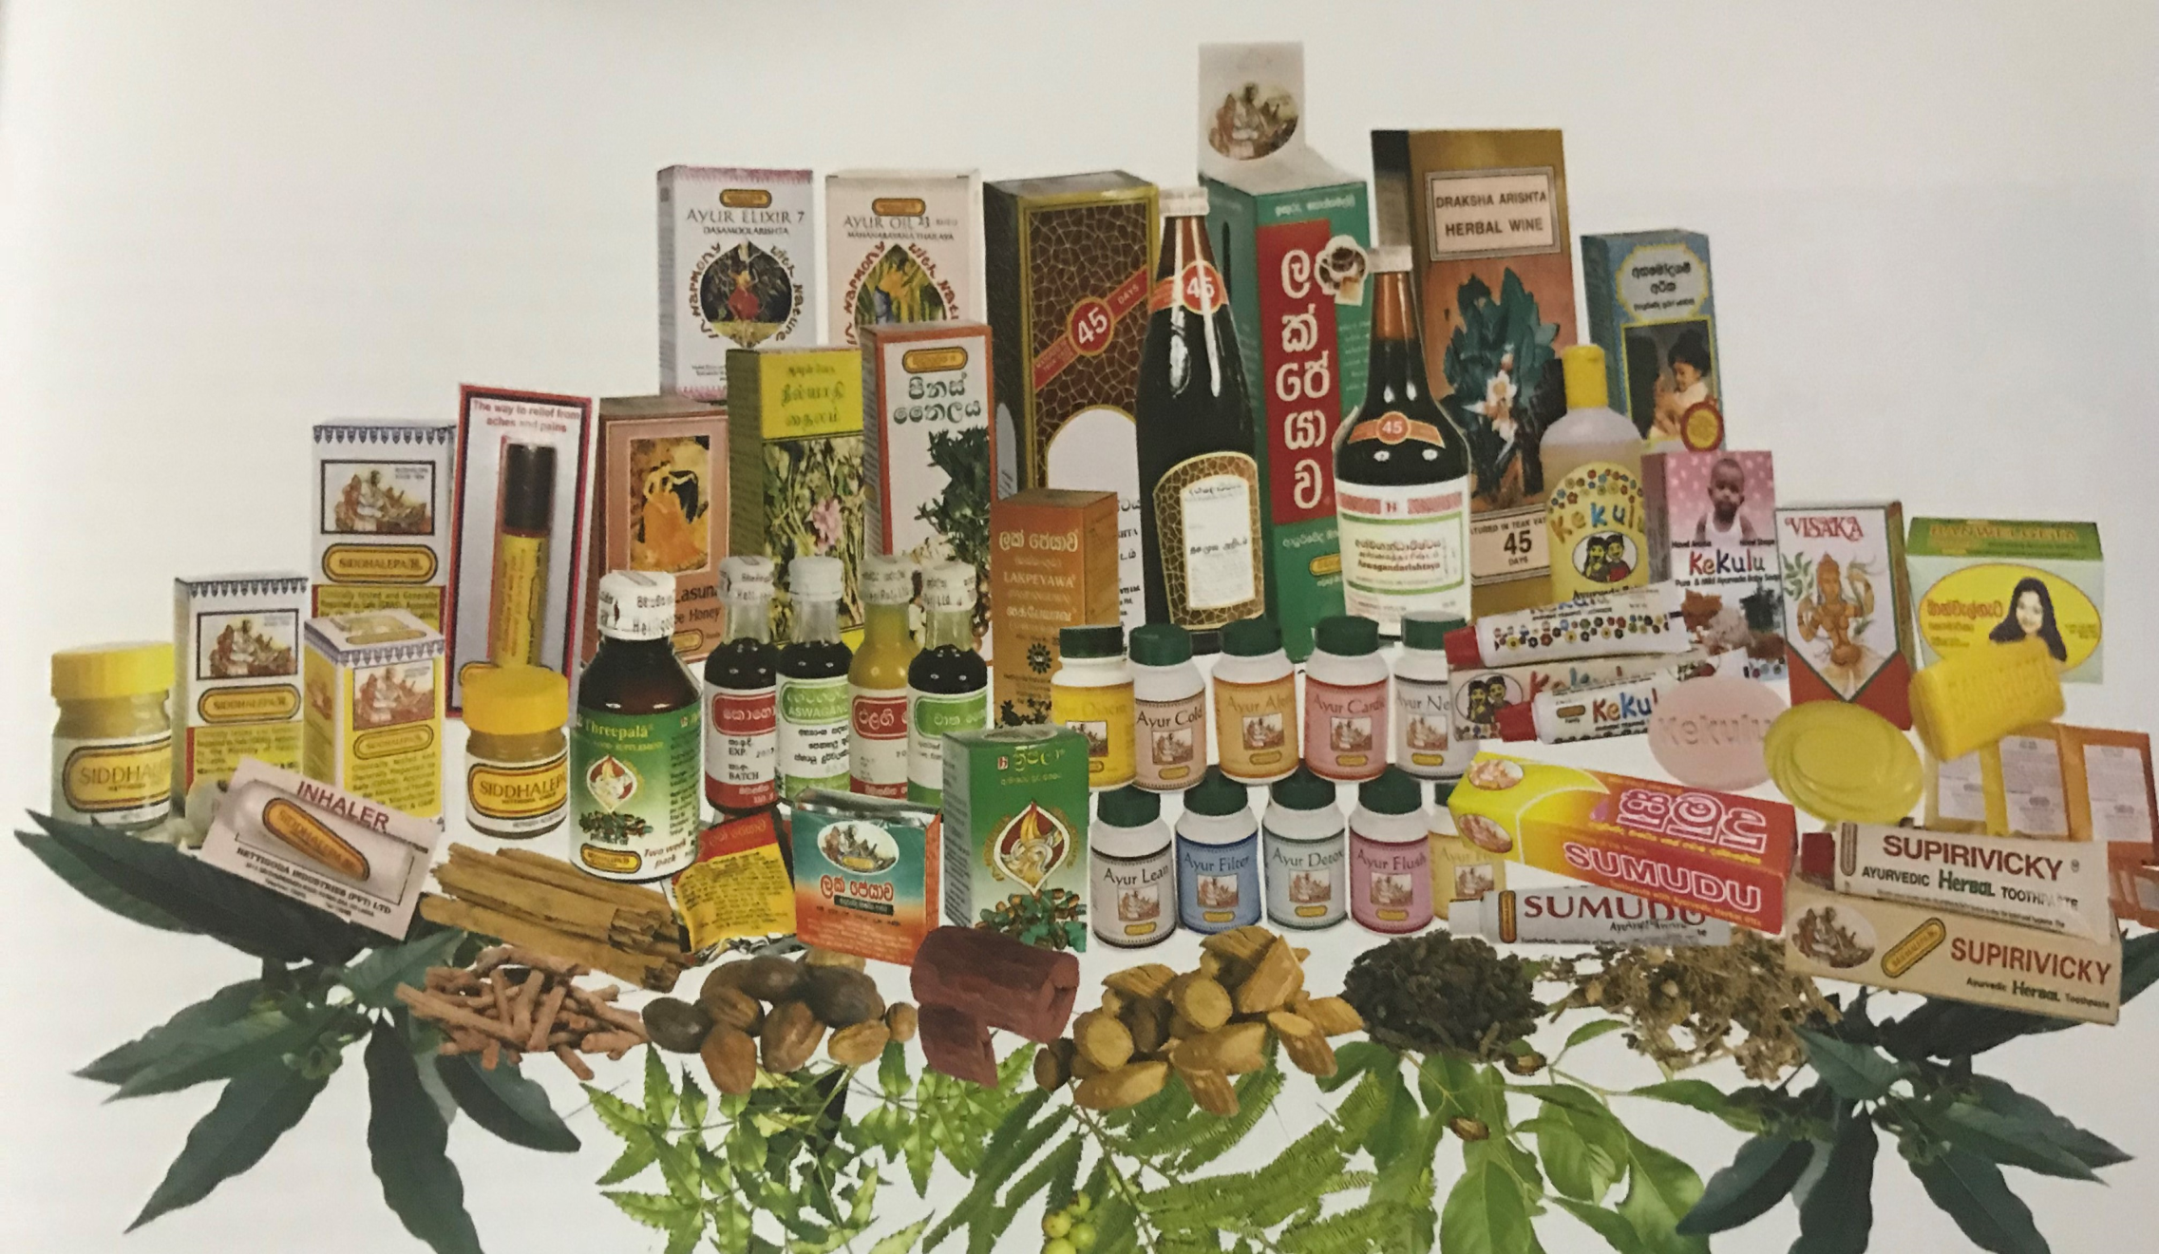
SIDDHALEPA Product Range

Slide 5
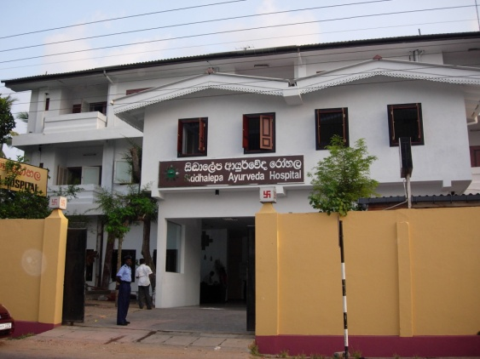
Siddhalepa Ayurveda Hospital
The Siddhalepa Ayurveda Hospital is dedicated to the memory of the late Dr. Hendrick de Silva Hettigoda, famous Astrologer and Ayurveda Kidney Specialist.
Outpatients Department
Patients can receive treatment throughout the week, at any time, day or night.
Consultation of Specialists
Specialist can be consulted on the patient’s request or upon the doctor’s recommendations.
Clinics
Ayurveda Doctors, specializing in the following diseases cab be channeled at our clinics: Polio and rheumatic ailments, Skin diseases, Dislocated bones,
And fractures, Eye diseases, Catarrh, Asthma, High blood Pressure, Diabetes and etc.
Pharmaceutical Factory
All medicines, used at the Siddhalepa Ayurveda Hospital, are scientifically prepared at our pharmaceuticals factory.
The “PANCHAKARMA” Unit
For a complete course of “Panchakarma” treatment, Channel one of the Specialist at the Unit.

Slide 6
Dedicated Ayurvedic Health Resort Surrounded by woodland & meadow, fronted by sparkling blue waters of the Indian Ocean
50 room Boutique Resort designed with local motifs with a touch minimalist sophistication to induce total relaxation with separate Yoga and Meditation Centre
Award winning Ayurvedic Cuisine featuring the abundantly available Sri Lankan Fruits and Vegetables
Specially designed Therapy packages include detoxification, rejuvenation, cleansing, Stress relief, weight control, balancing of the three doshas and general well-being.

Slide 7
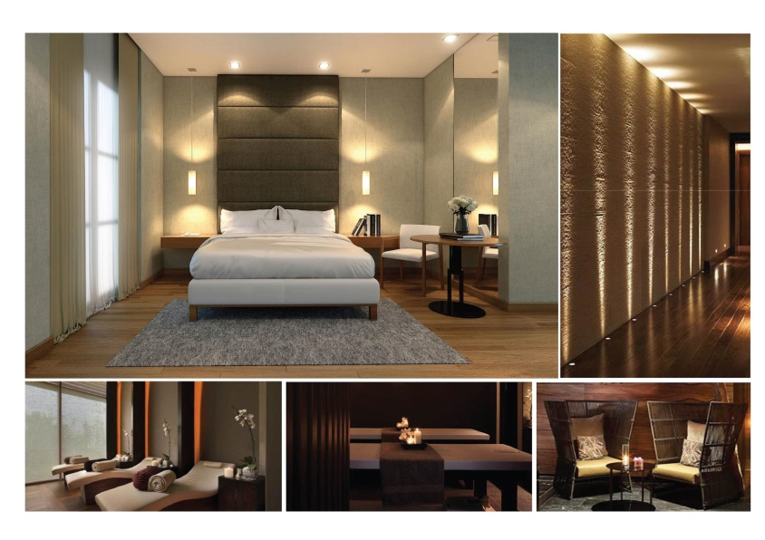
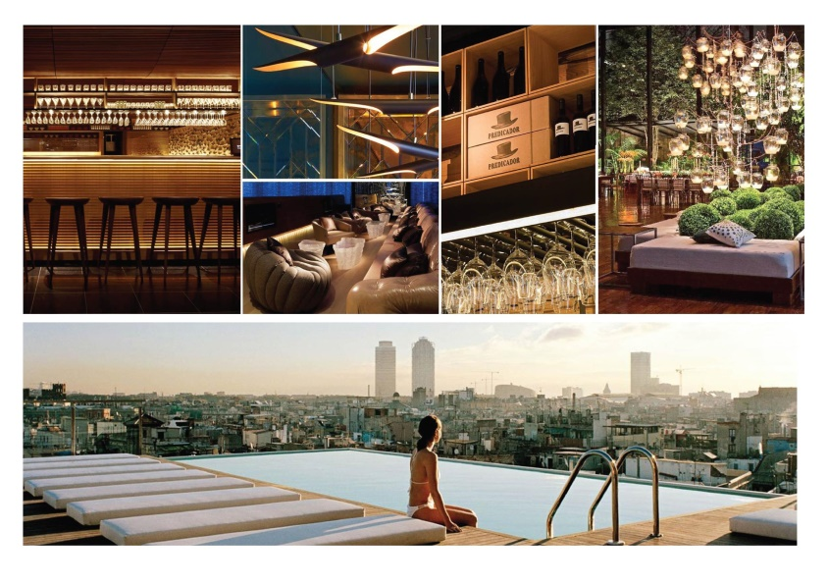
Anarva Mount Lavinia
Purpose built hotel for Medical Tourism

Slide 8
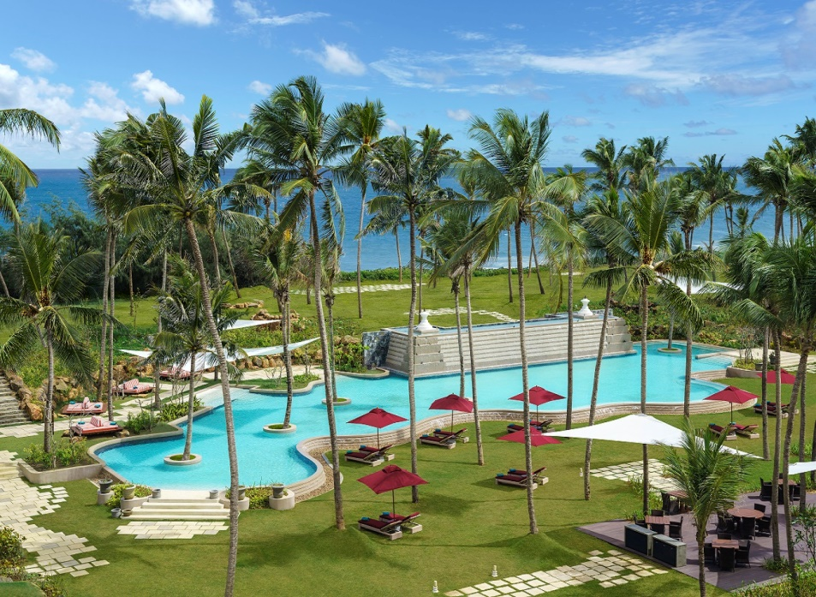
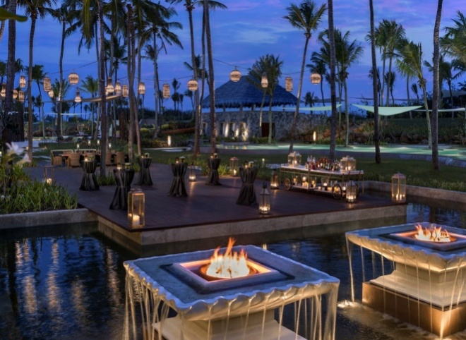
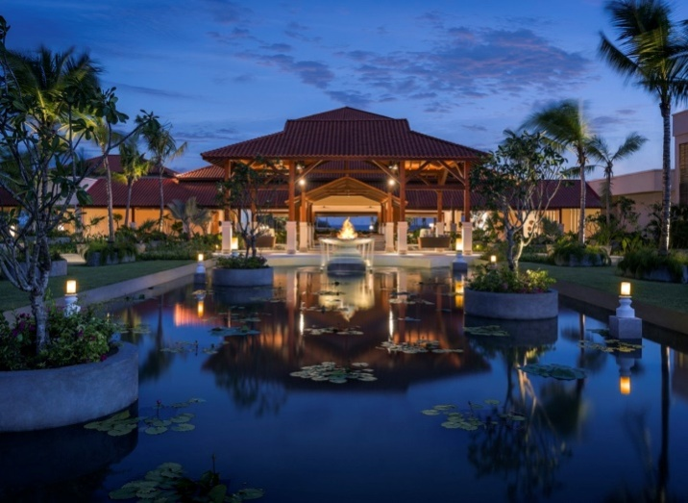

Slide 9
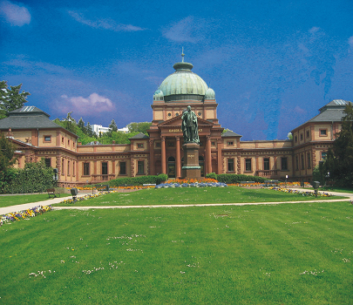
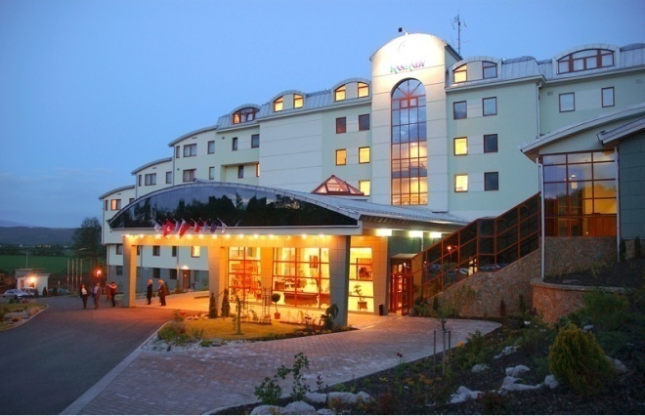
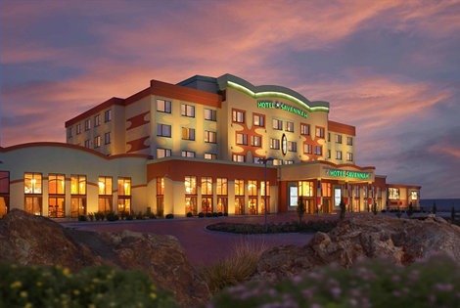
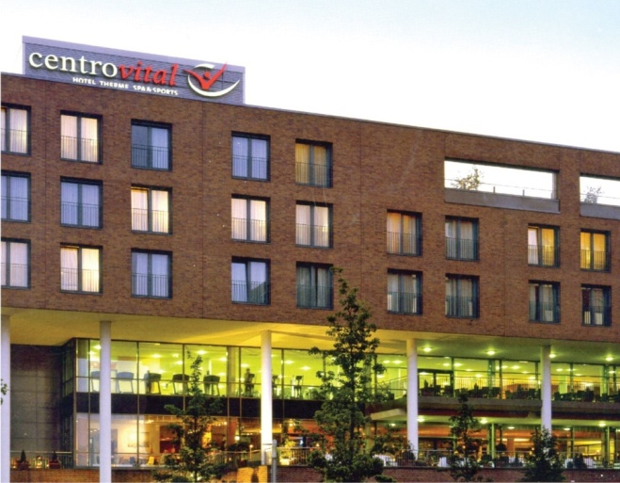
International
Frankfurt, Germany
Kaskady Resort & Spa Slovakia
Hotel Savannah
Czech Republic
Centrovital Hotel & Spa Berlin, Germany

Slide 10
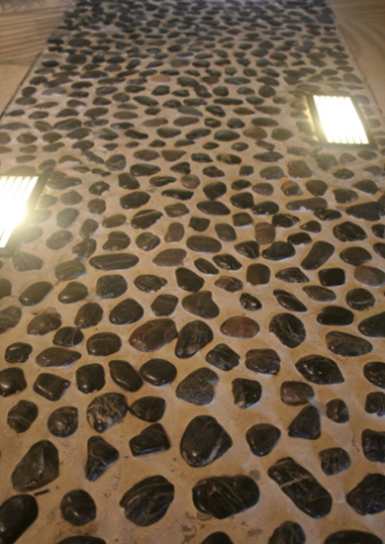
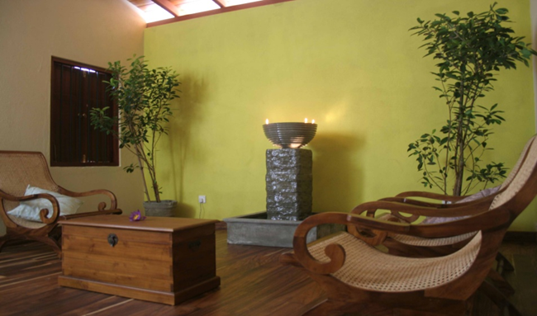
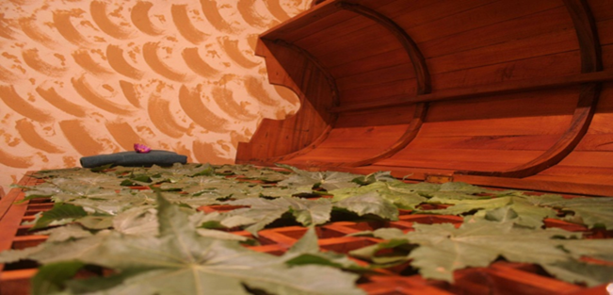
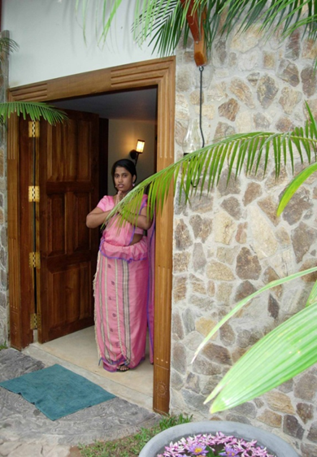
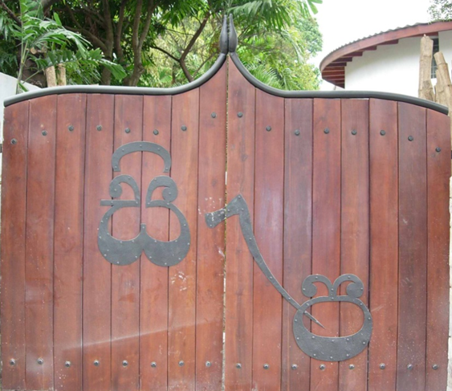
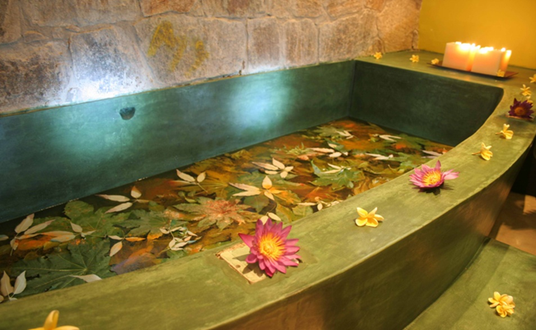
First authentic Ayurvedic Day SPA in the city of Colombo

Slide 11
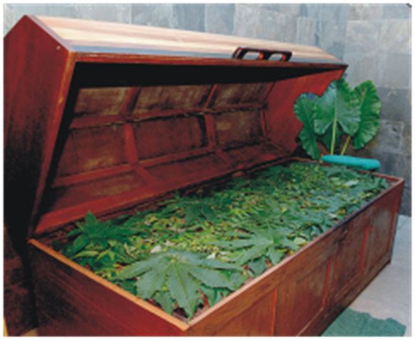
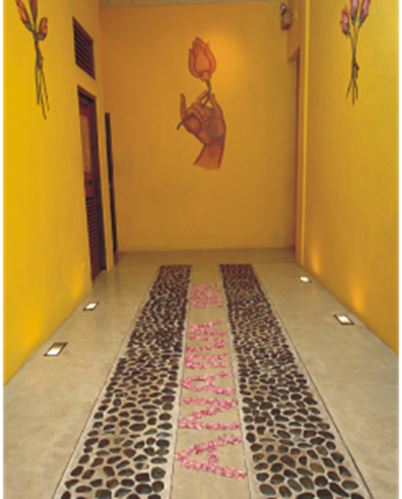
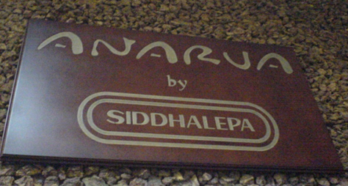
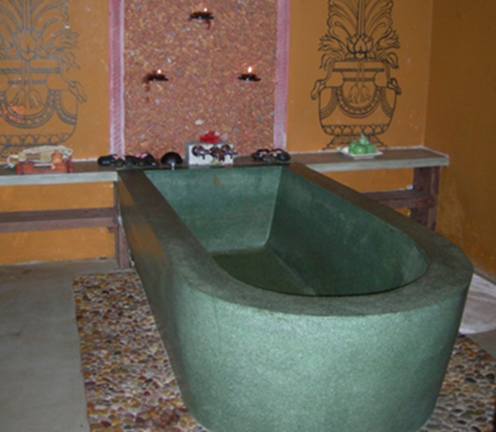
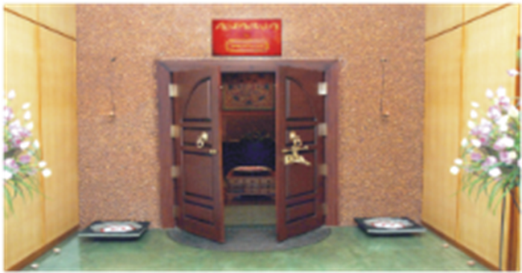
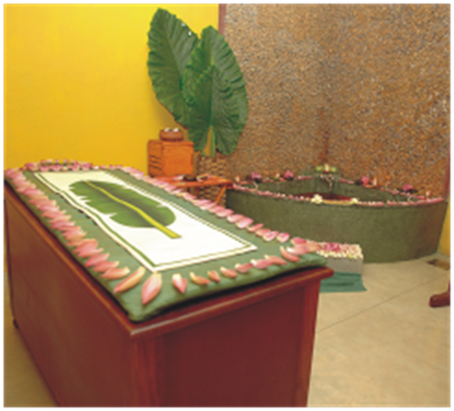
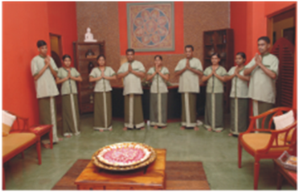
SPA

Slide 12
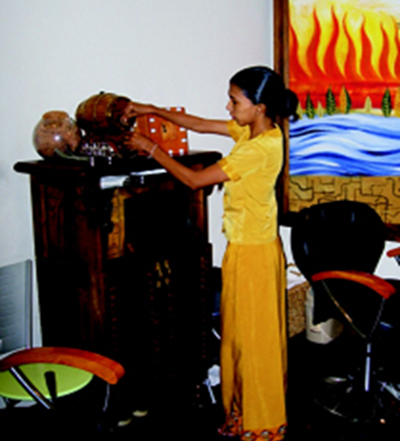
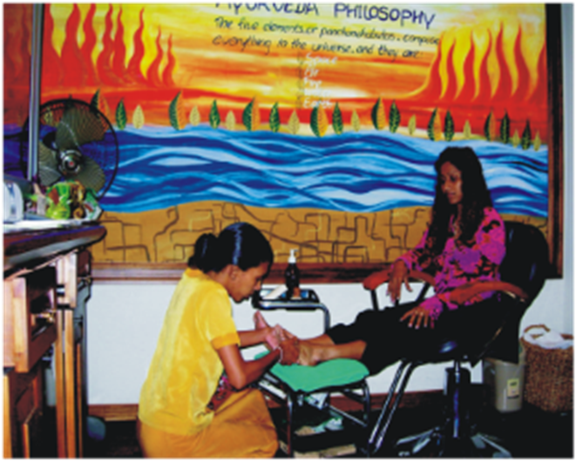
@
Serendib Business Class Lounge
Colombo International Airport
Sri Lanka
Pampered 150,000 Business Class Travellers (up to Nov 2018)

Slide 13
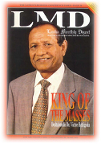
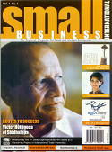
Chairman’s Achievements
Awarded an Hon. D.Litt from Univ. of Sri Jayawardenepura
Bestowed the Honour of “Deshabandu” by His Excellency the President in 1990
Awarded the Honour of “Vishva Prasadini” by the Prime Minister in 1996
ASIAWEEK called him the “Balm King of Sri Lanka”
Asian Business called him “The Barefoot Doctor”
Was Selected as one of the Hundred Best Doctors of the Century by Govt of Sri Lanka in 2001
LMD selected him as “Fifty Greatest Sri Lankans since Independence”
Interviewed by CNN and BBC

Slide 15
Entrepreneurial activities
1934 - Launched Siddhalepa Balm as Sri Lanka’s first commercial Ayurvedic product
1971 - Created a FMCG category for Ayurvedic Products
1971 - Creation of a company tagline
(An Ayurvedic doctor in every home)
1981 - Launched first Ayurvedic Soap, Visaka
1984 - First company to export Ayurvedic products
1988 - Opened Siddhalepa Hospital as the First purpose built Ayurvedic Hospital with Specialist Channel Consultations
1988 - First Ayurvedic Toothpaste, Supirivicky

Slide 17
Entrepreneurial activities
1989 - First Ayurvedic Mosquito Repellent, Maduthala – obtained an International Patent
1994 - First Ayurveda company in the world to obtain ISO 9000 international standards and currently holds ISO 9001, 14001, 18001, 22000, GMP, SLS, HACCP, OHSAS, FDA & EU Pharmacopeia.
1995 - First Certified Organic Fertilizer, Suraya, NASAA Australia
1999 - Opened Siddhalepa Ayurvedic Health Resort, country’s first purpose built Ayurvedic resort
2003 – Launched Diacin, First Ayurvedic remedy for Diabetes
2004 - First Ayurvedic Spa in a Business Class Lounge

Slide 18
Entrepreneurial activities
2004 - First company to setup Ayurveda Spas in Germany, Czech Republic, and Slovakia
2004 – Established Siddhalepa Germany, First Ayurveda company to start in Germany
2005 - First Sri Lankan Ayurvedic Doctor to present a Research paper at the International Federation of Diabetes, France
2005 - First Ayurveda company to conduct a FDA standard Research on Diabetes and publish its findings in International Journal of Ethno Pharmacology
2005 – Established Hettigoda Distributors India, First Sri Lankan Ayurveda Company to setup in India

Slide 20
Challenges in Entrepreneurship

Slide 21
Challenges in going Global
Economic Risks
Legal Risks
Sales Risks
Personnel Risks
Competitive Risks
Political Risks

Slide 22
Challenges in going Global

Slide 23
What we did in going Global
What are the best countries to enter?
Which business model is suitable for our company abroad?
Are our products competitive?
Is “Made in Sri Lanka” valued in that market?
Build relationships, networks, gain information about the market
Decide on price, design, packaging
Optimizing cost structures in transport, logistics
Analyse regulatory and legal procedures
How to finance expansion abroad?
How to deal with competition, risks etc.

Slide 24
Thank You.

